Slide 1
Marginalized and Key Populations Session:
Epidemiology of HIV and STI Epidemics among Sex Workers
STI 2018, Amsterdam
Kate Shannon, PhD, MPH
Professor of Medicine
Director, Gender and Sexual Health Initiative
University of British Columbia
Notes:
Many thanks for the invitation to speak today. It is truly an honour to be speaking to you today and comes at such a critical juncture in the global policy landscape on sex workers, rights & HIV. A special thanks to Chris and Stef for the invitation.

Slide 2
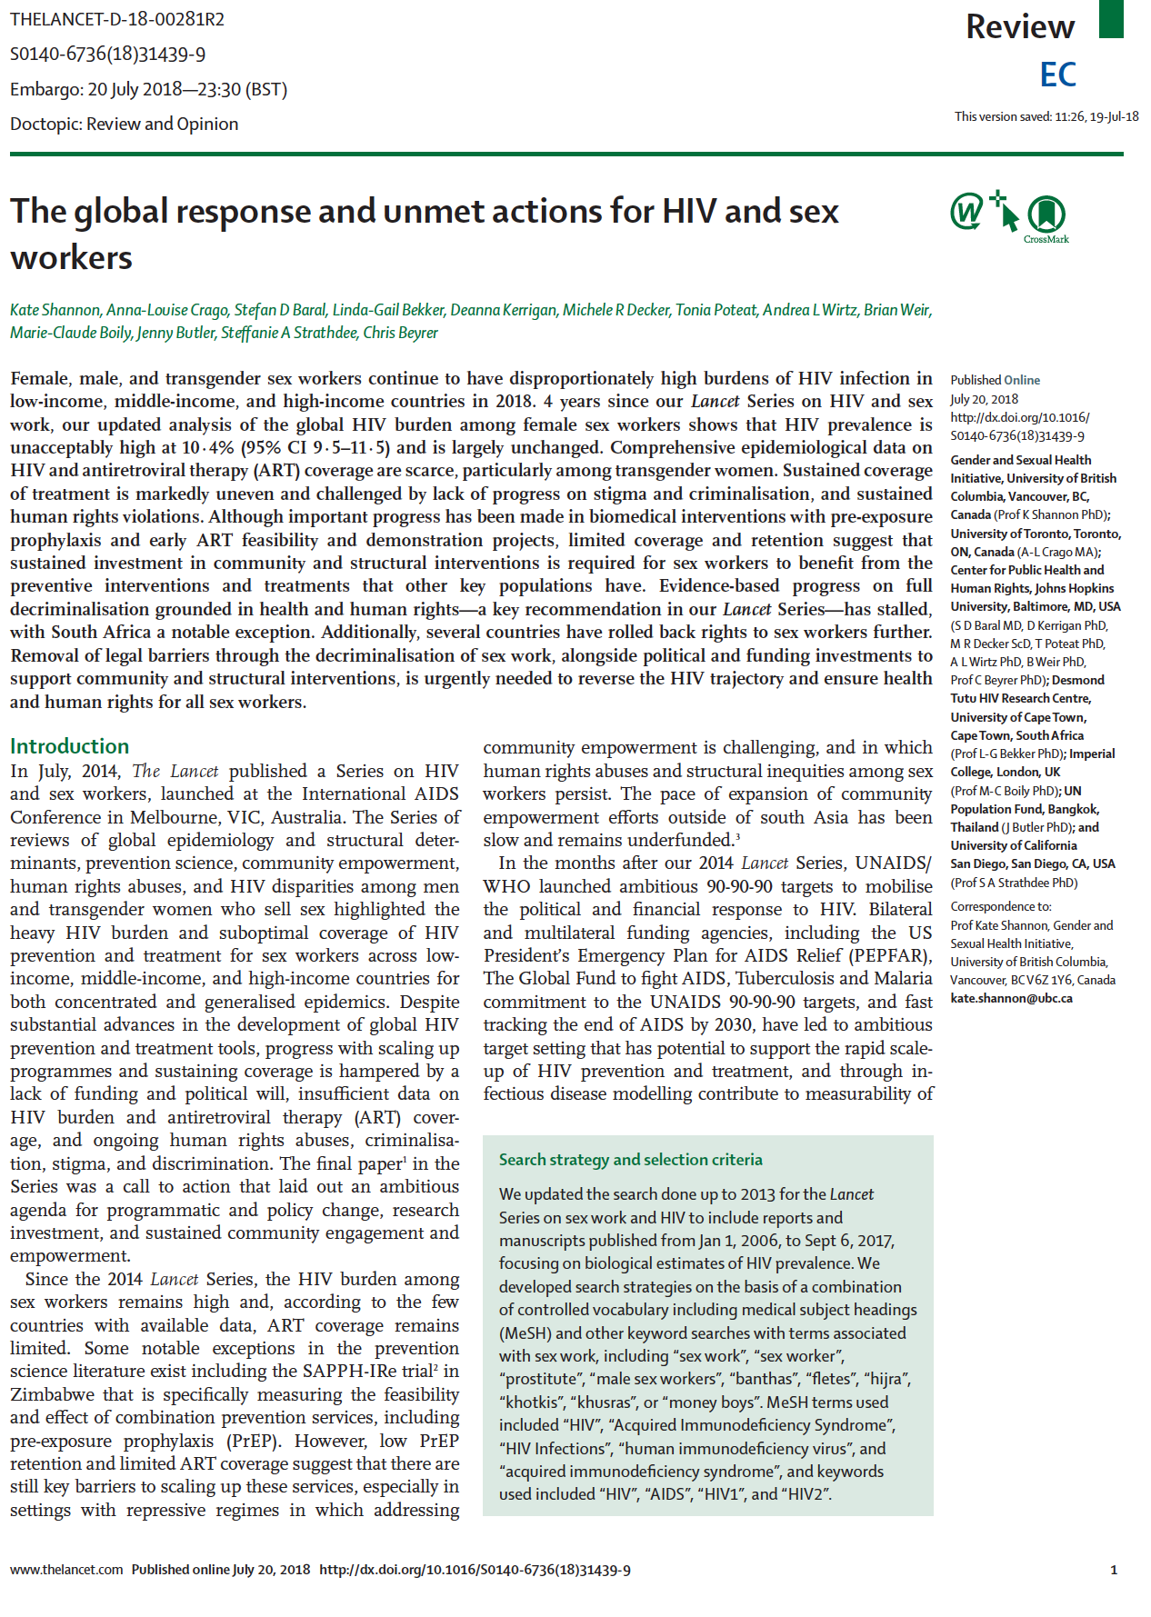

Slide 3
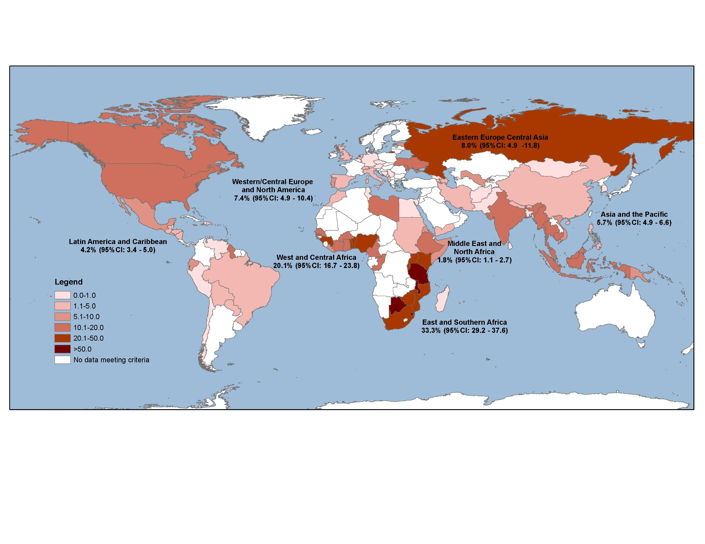
Global HIV Burden among Female Sex Workers, 2006-2017
Shannon, Crago, Baral, et al. Lancet 2018, The Global Response and
Unmet Actions on HIV and Sex Work
Notes:
This map from Andrea Wirtz – update from Beyrer 2014 Lancet. We are now 113 countries (compared to 79 in 2014) with HIV prevalence data …and yet,
In 2017, HIV burden remains unacceptably high at 12.5% (10.9-14.3) and largely unchanged from 2011 estimates (Baral et al)
HIV burden varies considerably both across and with regions not just by epidemic structures/ features (the epi/ e.g. prevalence among clients) but also by contextual and structural features that still largely remain elusive yet critical to understanding reach & estimating priorities for interventions and policies

Slide 4
Regional HIV estimates FSWs and all adult women

Slide 5
Male & Transgender Women Sex Workers
Trans Women Sex Workers
While majority of research focuses on cis women sex workers, there has been slow progress since 2014 with 18 studies among trans women sex workers
Small sample sizes and conflation of MSM and trans women remain
Male Sex Workers
22 studies since 2014
HIV and STI prevalence outcomes vary accordingly with MSM who sell sex often having higher burden of HIV compared to other MSM and male sex workers who professionally sell sex often having lower or equivalent burdens of HIV
Notes:
(two decades of PEPFAR anti-prostitution pledge)
– yet we now know that 5-20% of new infections in SSA are among female sex workers (Mishra, 2016)

Slide 6
Lack of Rights & the “Invisibility of Sex Work” in HIV
The “uncounted” (Davis 2017): Sex workers still largely not counted in most HIV surveillance data despite disproportionately high HIV burden –due to stigma, criminalization, and lack of political and financial investment
Sex workers have largely been invisible in generalized HIV epidemic settings (Bourquez, 2016, Mishra, 2016)
Human rights advances have been limited and in many settings, have been rolled back with wave of end-demand criminalization
Notes:
(two decades of PEPFAR anti-prostitution pledge)
– yet we now know that 5-20% of new infections in SSA are among female sex workers (Mishra, 2016)

Slide 7
Epidemiology of HIV / STIs
Sex workers risk for HIV/ STIs and other health inequities occurs within a context characterized by powerful structural and community determinants
Sex workers are exposed to multiple forms of violence, stigma and discrimination (vary by working conditions, policies, gender, race, economic and migration factors, and community/ social capital)
In the absence of addressing these structural factors, biomedical science & public health tools available will continue to have limited reach
Notes:
Some of most compelling data has been from southern African countries where TAPS demonstrations projects for PreP and early ART have high acceptability & initiation rates, but drop off is substantial by 6months.
There have been some advancements in combination prevention (SAPPH-IRE Trial, Zimbabwe, Cowan et al 2016; 2017), largely localized and the challenge remains in bringing to scale and reach

Slide 8
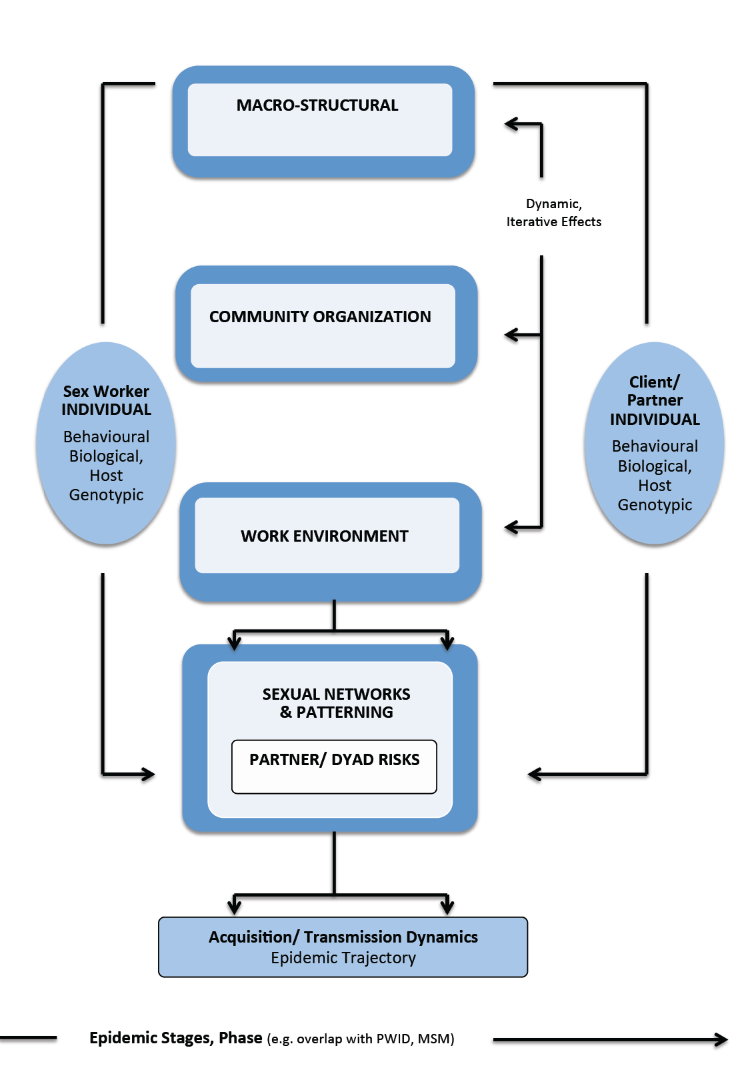
Shannon, Goldenberg, et al, Current HIV Opinions, 2014;
Socio-Ecological Models – Pathways to HIV/ STI epidemics
Notes:
We now have structural determinants and socio-ecological models to help guide more complex epidemiology analyses of HIV epidemic structures in sex work but research has been slow to catch up and structural and contextual factors that confound accurate HIV reporting remain under documented for many of the same reasons: lack of funding and political will, criminalization and stigma, and the ‘invisibility’ of sex work and HIV.
up

Slide 9
Macro-Structural Determinants
Macro-structural factors increasingly play a central role in HIV epidemic structures among FSWs
⬆ HIV
Criminalized and punitive laws & policies
Stigma, food insecurity & residential instability
Gender inequities & sex trafficking (forced labour)
HIV
Gender empowerment, higher education, literacy
⬆ HIV
Migration & mobility –complex, non-linear, context specific
Notes:
Macro-structural factors increasingly play a central role in HIV epidemic structures among FSWs, operating in iterative pathways with other structural, behavioural, biological factors
Key factors that increase HIV risk for FSW:
Criminalized and punitive laws & policies –criminalization of some or all aspects of sex work, incarceration, punitive restrictions on where/how sex workers operate (e.g. demolition on RLDs in India)
Stigma, food insecurity & residential instability as products of criminalization and punitive policies
Gender-based violence & sex trafficking (forced labour) – where FSWs have constrained rights and access to resources as sex workers + women, these factors increase HIV risk (where as, gender empowerment, higher education and literacy which reduce HIV risk)
Migration and mobility both mitigating and conferring HIV risks. For example, internal domestic and circular migration and mobility increase HIV risk, whereas longer duration of mobility and international migration from non-endemic settings reduce HIV risks. Other geographic features and epidemic structures (e.g., such as, rural vs. urban migration) that both may confer or mitigate HIV risk for FSW

Slide 10
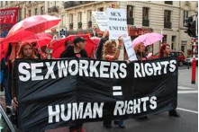
Community Empowerment – Mitigates HIV and STI Epidemics
In 2014, meta-analysis (Kerrigan et al, Lancet)
CE = 3X increased consistent condom use w/ clients CE = 32% reduction in odds of HIV infection
Since 2014, stil majority of research of CE interventions comes from South Asia & Avahan
Swaziland (Fonner et al) found social cohesion = increased condom use with clients & HIV testing
Lack of fincial resources and political investment in CE and criminalization and stigma continue to limit ability of SWs to organize
Notes:
SW organizing and community empowerment consistently shown to reduce HIV risks and looked at – both as:
Broad process of community empowerment (e.g. well-known Songachi, Avahan models).
Components of sex worker organizing (e.g. collectives, drop-in spaces, peer/ SW-led outreach)
The available data on sex worker organizing is largely restricted to India, where substantial resource investments have been made in community empowerment efforts among SWs as part of broader HIV prevention efforts; and large populations of sex workers have mobilized
Aside from a handful of reports from China, Kenya, and Latin America, gaps in data on community empowerment to date can be attributed in large part to lack of resources to evaluate grassroots sex worker efforts and macro-structural constraints of criminalization and stigma that limit the ability of FSWs to organize.

Slide 11
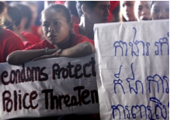
Work Environment Factors: Physical, Social, Policy & Economic Features
⬆ HIV risk
Physical and sexual workplace violence
Policing & law enforcement strategies
Suboptimal access to safe, appropriate sexual
health care, condoms, HIV/ STI testing, ART
Economic pressures
HIV risk
Supportive work environments
Higher sex work income, lack of economic dependence
Notes:
The work environment consists of intersecting social, physical, policy and economic features of places within which FSWs operate and work (e.g. venues, street and public spaces, online and other off-street self-advertizing spaces).
⬆ HIV risk
Physical and sexual workplace violence, whether
by clients, police, managers, pimps, or predators, are the most common factors reported and linked in all cases to increased HIV risk (including client condom refusal and non-condom use)
Law enforcement strategies & local policing, were examined as bi-products of criminalization including
arrest, incarceration, raids, condom confiscation
Suboptimal access to safe, appropriate condoms,
sexual health care, HIV and STI testing, ART
Economic pressures (client financial incentives, police bribes)
HIV risk
Supportive work environments –policy, social and physical features operate synergistically– supportive venue-based policies and/or managerial practices (e.g. safety mechanisms), physical layout (e.g. access to condoms), peer/ sex worker support
Higher SW income, lack of economic dependence

Slide 12
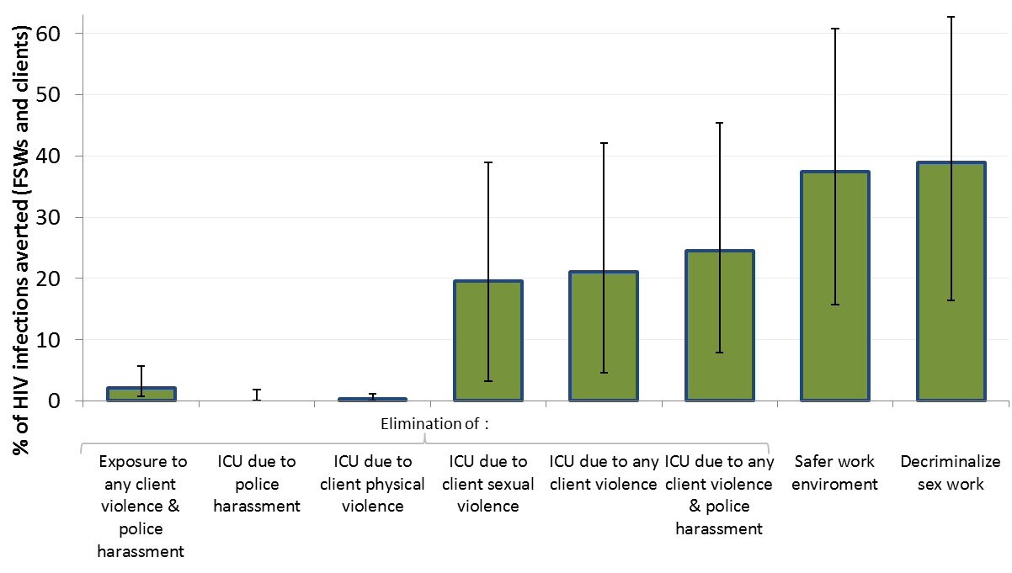
Notes:
In settings such as Kenya and Canada where sex work is criminalised and sexual violence against sex workers (by clients, police, partners, or strangers) remains endemic, elimination of sexual violence alone could avert 17–20% of HIV infections in sex workers and clients over the next decade.
Access to safer work environments (eg, venues with supportive policies and practices on violence, HIV, and access to condoms) could substantially shift the course of epidemics.
Decriminalisation of sex work could avert the largest percentage of HIV infections in sex workers and clients (33–46%) during the next decade, through iterative effects on violence, police harassment, safer work environments, and HIV transmission pathways.

Slide 13
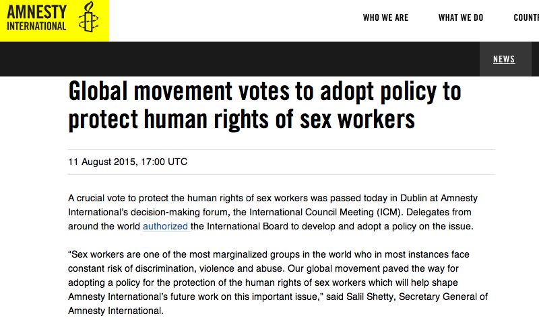
Global Human Rights Body Endorses
Decriminalization of Sex Work
Notes:
Perhaps the most significant policy advancement since our Lancet 2014 series is Amnesty International’s high-profile decision⁸ to call for full decriminalisation of sex work based on human rights and health evidence (Panel 1). While Amnesty International does not set policy, it wields tremendous influence in shaping policy frameworks globally, thus the impact of this recommendation cannot be overstated.
meaningful policy change has yet to be achieved in most settings and the harms of criminalisation continue to be articulated in shadow reports to CEDAW.
In criminalized environments, sex workers continue to report a profound lack of police protection, exacerbated by experiences of violence.²⁷
One notable exception is South Africa, where on December 20, 2017, the African National Congress (ANC) following huge efforts by the sex worker rights movement resolved to decriminalize sex work
Since 2014, Canada, Ireland and France have all implemented versions of criminalisation under an “end-demand model”. Large-scale anti-client raids have been reported alongside raids of sex workers in Tanzania. In 2016, a new bill was introduced in Uganda to criminalize clients of sex workers.⁶²

Slide 14
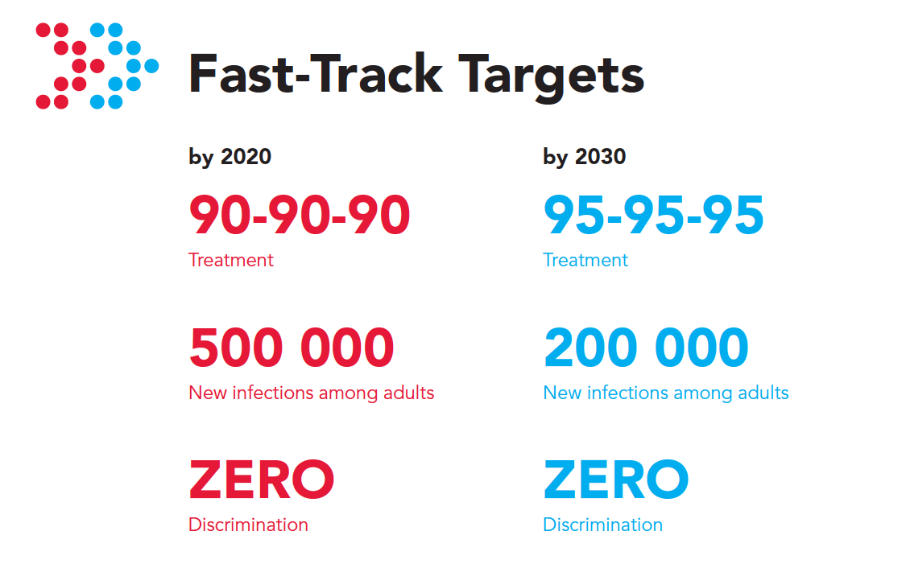
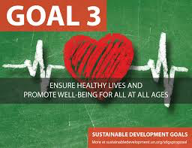
Implementation Challenges Persist:
Structural Constraints and Lack of Rights for Sex Workers
Despite launch of global markers, new data on HIV care continuum, early ART and PreP remain patchwork at best
Structural constraints and lack of denominators impede ability to bring interventions to scale and reach

Slide 15
Combination Prevention Science- Advances & Challenges
The SAPPHIRE trial in Zimbabwe found high prevalence (77.8%) of VL suppression among sex workers taking ART (67.7%), but only 49.5% with suppressed VL among all FSW living with HIV (Cowan et al, 2017)
In Uganda, sex workers were most likely to experience delayed initiation relative to the general population during the roll-out of early ART initiation (Mayanja et al 2017)
Higher ART retention was observed in South Africa, with only 30% loss to follow-up at 12 months, similar to current standard of care (Eakle et l, 2017)
Since 2014, increased feasibility of oral PreP, HIVST, and microbicides but also implementation challenges (fears of breach of confidentiality, violence situations, side effects)

Slide 16
Conclusions: Where to Now?
Three decades into the epidemic, comprehensive epidemiological data characterizing the HIV epidemic in sex work are limited
Sex workers continue to have a high HIV burden, largely unchanged from 2011
Understanding structural and community features of rights & HIV are critical to estimating priorities, reach and targets for interventions and policies
Growing science that criminalization of sex work fails to protect rights and exacerbates HIV & other health inequities
We need more complex, multi-level data, modelling of structural and biological factors and evaluation of legal and policy approaches, in partnership with sex work community

